Slide 1
Waveforms

Slide 2
Graphs
Graphs are given in terms of Amplitude vs time.
The instantaneous value of a given quantity at a specific point in time
Waveforms that are composed of identical cycles that keep repeating are repetitive waveforms or periodic waveforms
Waveforms that are not identical for succesive cycles are termed aperiodic waveforms

Slide 3
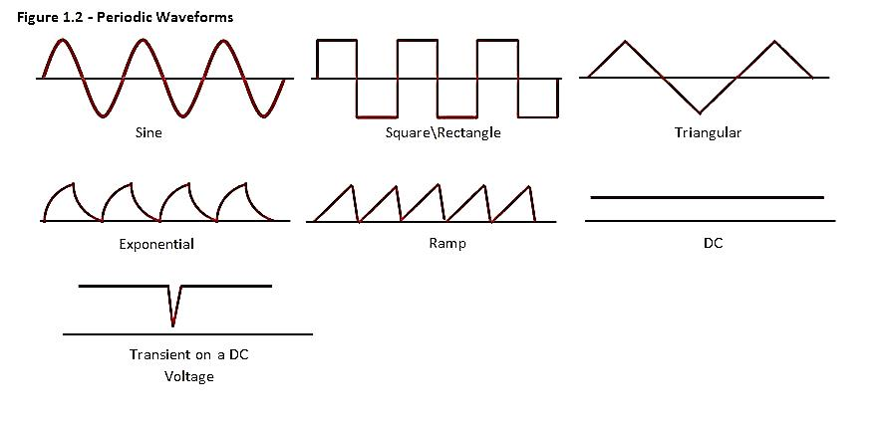
Periodic Waveforms
Transients are Aperiodic waveforms

Slide 4
Frequency Synthesis
Frequency synthesis is the process of combining multiple sine waves to produce a desired waveform
Square waves are comprised of infinite number of odd harmonic sine waves
Saw tooth, exponential, and triangle waveforms are comprised of a combination of odd and even harmonic sine waves.

Slide 5

Frequency Synthesis
V_{A}
f =f_{A}
A
V = V_{A} + V_{B}
V_{B} = $\frac{1}{3}$V_{A}
f =f_{A}
B
f_{B} = 3f_{A}

Slide 6


Frequency Synthesis
V_{A}
f =f_{A}
V_{B} = $\frac{1}{3}$V_{A}
V = V_{A} + V_{B} + V_{C}
f =f_{A}
V_{C} = $\frac{1}{5}$V_{A}
f_{B} = 3f_{A}
f_{C} = 5f_{A}

Slide 7
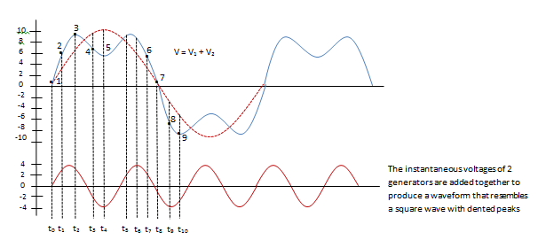
Frequency Synthesis

Slide 8
Harmonic Analysis
Harmonic analysis is a process by which a waveform is analyzed to discover the individual sine wave frequencies it contains.
A harmonic is a multiple of the fundamental.
Harmonics are numbered according to their ratio to the fundamental.
The number of harmonics is infinite, and the amplitude of each harmonic will decrease as the frequency increases.

Slide 9
Harmonic Analysis
Harmonic number | Frequency | Amplitude
Fundamental | f | V
2nd Harmonic | 2f | 1/2V
3rd Harmonic | 3f | 1/3V
4th Harmonic | 4f | 1/4V
5th Harmonic | 5f | 1/5V
7th Harmonic | 7f | 1/7V
100th Harmonic | 100f | 1/100V

Slide 10
Harmonic Analysis
Symmetrical square waves are composed of the fundamental and only odd harmonics with no DC component.
Asymmetrical square waves have a combination of odd harmonics and some DC component.
Saw tooth waveforms, triangular waveforms, and rectified sine waves are made up of more complicated combinations of harmonics

Slide 11
Harmonic Analysis
A perfect square wave has an infinite number of odd harmonics.
The number of harmonics passed through a circuit will directly affect the shape of the waveform.
Waveform distortions are caused by the number of harmonics passed through a circuit.

Slide 12
Harmonic Analysis
If an amplifier has a bandwidth of 1.5MHz, and a 3kHz square wave was passed through it, How many harmonics would be present in the output waveform?
Harmonic frequency = #of Harmonic * fundamental
1.5MHz = # * 3kHz
# = 1.5MHz/3kHz
= 500 harmonics

Slide 13
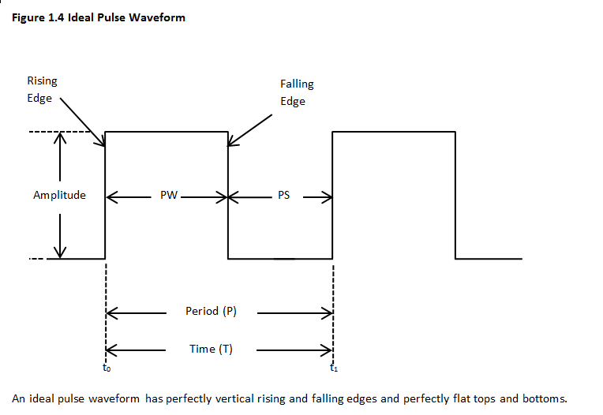
Components of a Pulse waveform
Period is the time from one rising edge to the next rising edge
Pulse width (PW), and Pulse Spacing (PS) are measured at 50% of the waveform amplitude
Pulse Repetition Frequency (PRF) is the inverse of the period.

Slide 14
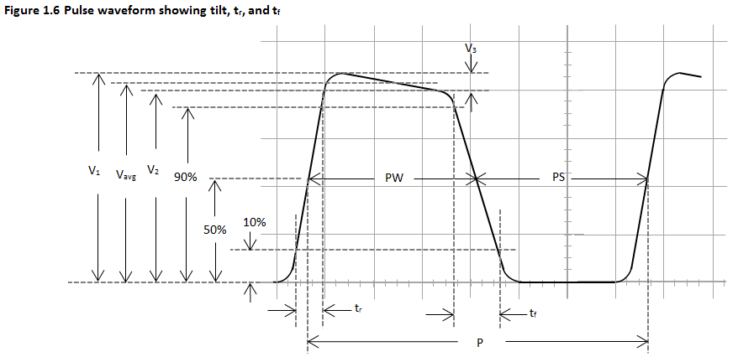
Pulse waveforms

Slide 15
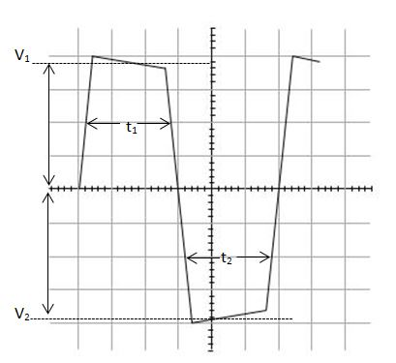
Pulse waveforms
AWV(Average Waveform Voltage)
V1 = +8V and V2 = -10V
t1 = t2 = 50us

Slide 16
Pulse waveforms
V1 = +8V and V2 = -10V
t1 = 30us,
t2 = 10us

Slide 17
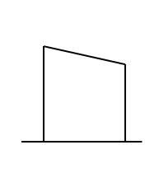
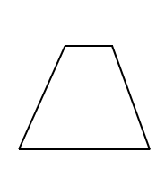
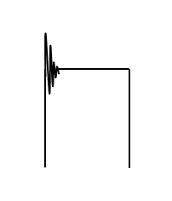
Waveform Distortions
3 main types of waveform distortions
TILT – Low frequency Distortion
Distorted tr/tf – High frequency Distortion
Ringing – High frequency Distortion

Slide 18
Waveform Distortions
3 main types of waveform distortions
TILT – Low frequency Distortion caused by series capacitance
Distorted tr/tf – High frequency Distortion caused by parallel capacitance
Ringing – High frequency Distortion caused by overemphasis of high frequency components.

Slide 19
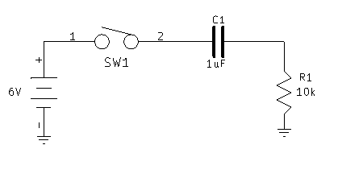
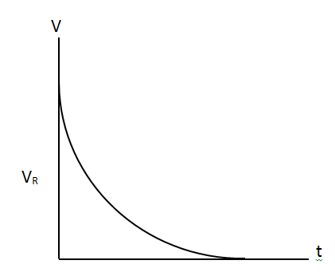
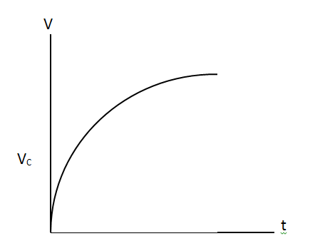
RC Circuits
TILT – Low frequency Distortion caused by series capacitance
RC circuits
The charge on a capacitor is given by the equation:
And :
From these 2 equations we can determine that if t is longer the capacitor will charge more, and see less voltage across the resistor

Slide 20
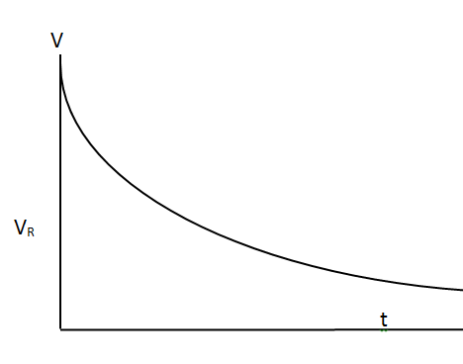
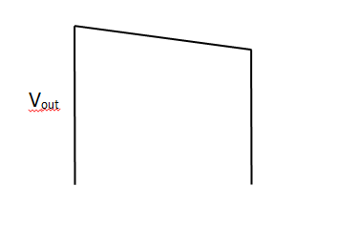
RC Circuits
As the frequency decreases, the PW becomes longer
Which means the capacitor has longer to charge resulting in more voltage seen across the capacitor and less voltage seen across the load resistor, which results in more tilt.
Tilt is a low frequency distortion caused by series capacitance.
The low frequency response can be calculated using fractional tilt:

Slide 21
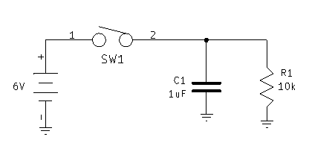
RC Circuits
Distorted rise time and fall time are high frequency distortions caused by parallel capacitance
Once again, the charge on a capacitor is given by the equation:
And :

Slide 22
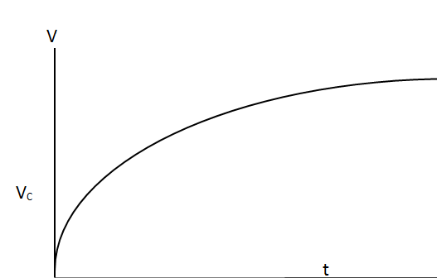
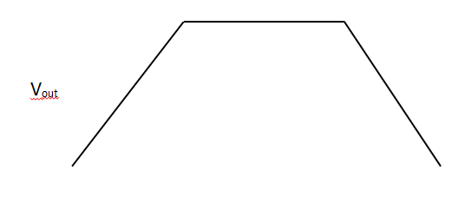
RC Circuits
As the frequency increases, the PW becomes shorter
Since the output is taken across the parallel capacitor and resistor, and the capacitor has less time to charge, the output will result in longer risetime and fall time.
Consider the equation:
Manipulate this equation to solve for time:

Slide 23
RC Circuits
Now consider the rise time is the time it takes for the waveform to increase from 10% of APA to 90% of APA where APA is V_{f}
Factor V_{f}:
Now consider the cutoff frequency equation:
Where
So :

Slide 24
RC Circuits
If f is the cutoff frequency and t is the rise time, this equation shows that the rise time directly affects the upper cutoff frequency is
As the frequency increases the PW is short and the circuit does not have sufficient time to rise from 10% amplitude to 90%.
The high cutoff frequency is determined by the amount of time it takes the charge of the capacitor. Also affected by the duty cycle which determines the PW of the input waveform.

Slide 25
RC Circuits
Example:
A pulse waveform is applied to the input of an amplifier:
Determine the minimum F_{ch} for an acceptable reproduction of the waveform if the risetime is 10% of the pulse width

Slide 26
RC Circuits
If the 1.5kHz pulse is to be amplified by an amplifier that has a 1Mhz F_{ch}.
What is the minimum pulse width and DC that can be reproduced?

